Slide 1
PROBLEM SOLVING AND COMPUTER PROGRAMMING
Lecture 05:
Classes

Slide 2
Classes
Class is a user defined data type, which holds its own data members and member functions, which can be accessed and used by creating instance of that class.
The variables inside class definition are called as data members and the functions are called member functions.

Slide 3
Class in C++ programming language is a mechanism to define a user defined data type achieving:
  Definition of data items – members
  Definition of associated operations as functions – member functions
  Putting the data definition and member functions together – encapsulation
  Possible to hide data definitions and / or implementation details of member functions – information hiding.
A user defined data type using class can be termed as Abstract Data Type (ADT).
ADT is an abstraction of Data Type (built-in).

Slide 4
Creating a class
A class is defined in C++ using class keyword followed by the name of the class.
Syntax:
      class className {
      // some data
      // some functions
      };

Slide 5
Access Control in C++
Access modifiers in C++ class defines the access control rules. C++ has 3 new keywords introduced, namely,
public
private
protected

Slide 6
public Access Modifier
The public keyword is used to create public members (data and functions).
The public members are accessible from any part of the program.
private Access Modifier
The private keyword is used to create private members (data and functions).
The private members can only be accessed from within the class.
However, friend classes and friend functions can access private members.

Slide 7
protected Access Modifier
protected keyword is used in inheritance concept.
The protected keyword is used to create protected members (data and function).
The protected members can be accessed within the class and from the derived class.

Slide 8
class MyClass {
public:
int x;
private:
int y;
};
int main() {
MyClass p;
p.x = 25; // Allowed (public)
p.y = 50; // Not allowed (private)
return 0;
}

Slide 9
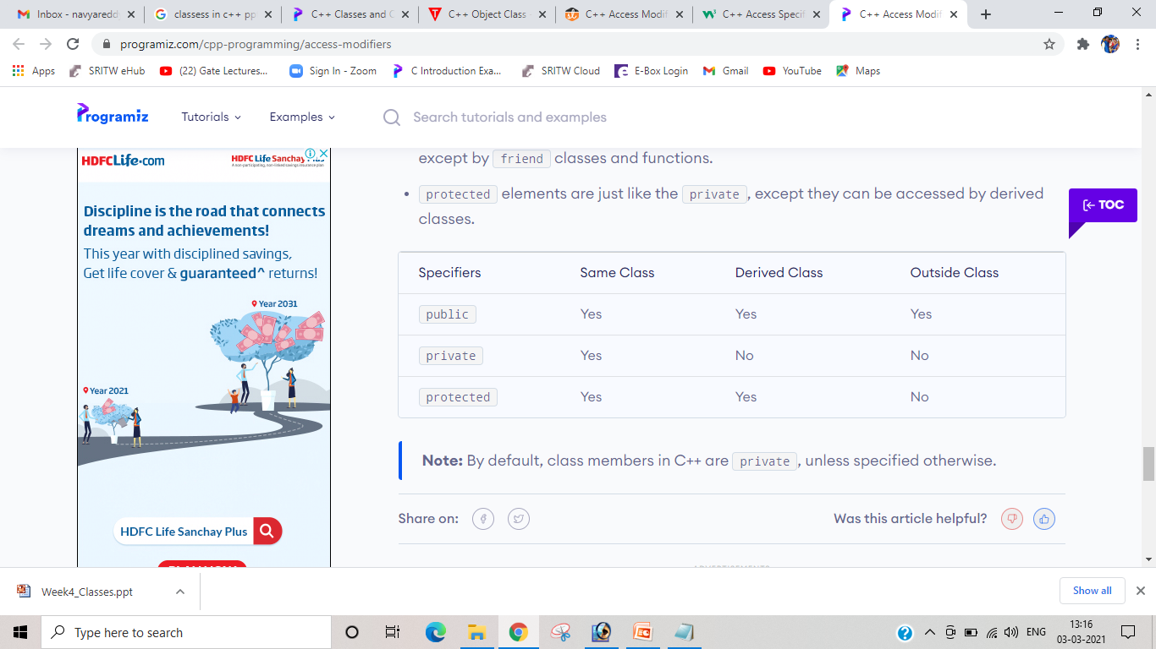

Slide 10
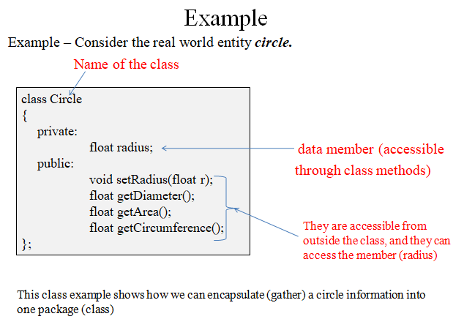

Slide 11
Creating Objects
To create a class
class Student
{
public:
int rollno;
string name;
};
To create object
For example:
class Student { public: int rollno; string name; }A,B; | int main() { Student A; Student B; }

Slide 12
Accessing Data Members of Class
If its public, then the data member can be easily accessed using the direct member access (.) operator with the object of that class.
If the data member is defined as private or protected, then we cannot access the data variables directly. Then we will have to create special public member functions to access, use or initialize the private and protected data members.

Slide 13
Accessing Public Data Members
class Student {
public:
int rollno;
string name;
};
int main() {
Student A;
Student B;
A.rollno=1;
A.name="Adam";
B.rollno=2;
B.name="Bella”;
cout <<"Name and Roll no of A is: "<< A.name << “ “ <<A.rollno;
cout <<"Name and Roll no of B is: "<< B.name << “ " << B.rollno;
}

Slide 14
Class Methods
Methods are functions that belongs to the class.
There are two ways to define functions that belongs to a class:
  Inside class definition
  Outside class definition

Slide 15
Inside Example
#include <iostream>
using namespace std;
class MyClass {
public:
void myMethod() {
cout << "Hello World!";
}
};
int main() {
MyClass myObj;
myObj.myMethod();
return 0;
}

Slide 16
Outside Example
To define a function outside the class definition, you have to declare it inside the class and then define it outside of the class. This is done by specifying the name of the class, followed the scope resolution :: operator, followed by the name of the function
Example: class MyClass {
    public:
    void myMethod();
    };
    void MyClass::myMethod() {
    cout << "Hello World!";
    }
    int main() {
    MyClass a;
    a.myMethod();
    return 0;
    }

Slide 17
Example:
class Box {
public:
double length, breadth, height;
double getVolume(void);
void setLength( double len );
void setBreadth( double bre );
void setHeight( double hei );
};
double Box::getVolume(void) {
return length * breadth * height;
}
void Box::setLength( double len ) {
length = len;
}
void Box::setBreadth( double bre ) {
breadth = bre;
}
void Box::setHeight( double hei ) {
height = hei;
}

Slide 18
int main() {
Box Box1; // Declare Box1 of type Box
Box Box2; // Declare Box2 of type Box
double volume = 0.0; // Store the volume of a box here
Box1.setLength(6.0);
Box1.setBreadth(7.0);
Box1.setHeight(5.0);
Box2.setLength(12.0);
Box2.setBreadth(13.0);
Box2.setHeight(10.0);
volume = Box1.getVolume();
cout << "Volume of Box1 : " << volume <<endl;
volume = Box2.getVolume();
cout << "Volume of Box2 : " << volume <<endl;
return 0;
}

Slide 19
Special Member Functions
Constructor: Are the methods of class used to initialize the data members of the class and have the following properties -
      Same name as class
      Public function member
      called when a new object is created (instantiated).
      Initialize data members.
      No return type
      Several constructors
      Function overloading (same function name with different arguments)

Slide 20
Types of Constructors
There can be 3 types of constructors in C++.
Default constructor
Parameterized constructor
Copy Constructor
Default Constructor
A constructor which has no argument is known as default constructor. It is invoked at the time of creating object.

Slide 21
Example for default constructor
class Cube { public: int side; Cube() { side = 10; } }; int main() { Cube c; cout << c.side; } | class Cube { public: int side; }; int main() { Cube c; cout << c.side; }

Slide 22
Parameterized Constructor
  class Cube
  {
  public:
  int side;
  Cube(int x)
  {
  side=x;
  }
  };
  int main()
  {
  Cube c1(10);
  Cube c2(20);
  cout << c1.side;
  cout << c2.side;
  }

Slide 23
Constructor Overloading
class Student
{
public:
int rollno;
string name;
Student(int x)
{
rollno = x;
name = "None";
}
Student(int x, string str)
{
rollno = x;
name = str;
}
};
int main()
{
Student A(10);
Student B(11, "John");
}

Slide 24
Copy Constructors
These are special type of Constructors which takes an object as argument, and is used to copy values of data members of one object into other object
It is usually of the form X (X&), where X is the class name. The compiler provides a default Copy Constructor to all the classes.
Syntax:
Classname(const classname & objectname)
{
. . . .
}

Slide 25
class A
{
public:
int x;
A(int a) // parameterized constructor.
{
x=a;
}
A(A &i) // copy constructor
{
x = i.x;
}
};
int main()
{
A a1(20); // Calling the parameterized constructor.
A a2(a1); // Calling the copy constructor.
cout<<a2.x;
return 0;
}

Slide 26
Destructors
Destructor is a special class function which destroys the object as soon as the scope of object ends. The destructor is called automatically by the compiler when the object goes out of scope.
      Same name as class but preceded with tilde (~) character
      No arguments
      No return value
      Cannot be overloaded
class A
{
public:
~A()
{
// statement
}
};
      Destructors will never have any arguments.

Slide 27
Example to see how Constructor and Destructor are called
class A
{
A()
{
cout << "Constructor called";
}
~A()
{
cout << "Destructor called";
}
};
int main()
{
A obj1;
int x = 1
if(x)
{
A obj2;
} // Destructor Called for obj2
} // Destructor called for obj1

